Slide 1




Slide 2

ORAL COMMUNICATION
(LISTENING SKILLS)(“POWER OF LISTENING ,LISTENING VS HEARING, BARRIERS TO LISTENING BAD LISTENING HABITS,ACTIVE LISTENING”)

Slide 3

TEST TIME ON READING SKILL 2
QR CODE:

Slide 4
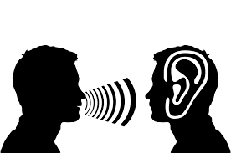
INTRODUCTION
What are listening skills?
Notes:
Listening skills are skills that contribute to your ability to accurately receive information when communicating with others. These skills are an important part of effective communication in the workplace. Developing good listening habits can help to ensure you understand the information correctly, interpret messages accurately and optimise your conversations and communications for efficiency.

Slide 5
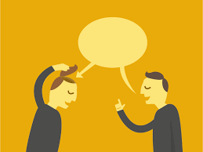
CONCEPTS
Why are listening skills important?
Notes:
Developing skills that can help you become a better listener is important for several reasons, including:
Building relationships
Good listening can help you build and maintain positive relationships in the workplace. Showing interest when communicating with others can help you build trust and develop long-term, mutually beneficial professional relationships. Good listening can help you prevent misunderstandings between coworkers, perform your duties accurately and anticipate the needs of your customers.
Learning new skills
Effective listening is an important way to help you learn new skills. In order to accurately follow directions, it may be beneficial to develop skills and habits that contribute to the quality of your listening. By listening closely to the advice, guidance and directions of your mentors or supervisors, you may be able to learn new skills and advance your range of capabilities.
Performing effectively
Listening intently can help you accurately follow directions. By following directions exactly, you may be able to improve your performance in the workplace. By listening closely to directions, guidelines and requirements, you may be able to avoid errors and improve your processes.

Slide 6
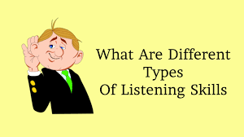
CONCEPTS
Types of listening skills
Notes:
Below are four types of listening that can help you become a better listener:
Deep listening
Deep listening occurs when you're truly committed to understanding the speaker's perspective and message. Deep listening includes paying attention to verbal and non-verbal cues in order to gain a full understanding of the speaker's experiences, thoughts, feelings and objectives. This type of listening is especially useful when building relationships, establishing trust and fostering rapport with coworkers, customers, clients or vendors.
Full listening
Full listening includes trying to fully comprehend the practical content of a speaker's message. This type of listening often involves active listening skills, like paraphrasing and asking clarifying questions. Full listening can be particularly helpful when interpreting directions, learning new material or developing new skills.
Critical listening
Critical listening involves using logic and reasoning to separate opinion and fact when listening to a speaker's message. Critical listening usually involves using your previous knowledge or experiences to identify factual content in communication. Critical listening can be especially important in professions that use persuasive speaking, debating or investigatory skills.
Therapeutic listening
Therapeutic listening is a more intimate type of listening that often involves receiving information from a speaker about their challenges or emotional situations. In the workplace, this type of listening is often an important part of succeeding in a career that deals with sensitive topics or emotional discussions. Therapists, doctors and counsellors often benefit from developing their therapeutic listening abilities.

Slide 7

CONCEPTS
How to practise active listening skills
Notes:
Active listening is a combination of techniques that include careful listening, observation and non-verbal clues. Below are seven skills that can help you improve your active listening abilities:

Slide 8

CONCEPTS
1. Limit distraction
Notes:
An important part of active listening is limiting distraction so you can gather all the necessary information and details of your speaker's message. Limiting distraction could mean putting your phone away before entering into a conversation, having important conversations in a quiet, private space or allowing yourself a brief pause to ensure you fully understood the message of your speaker before responding.

Slide 9
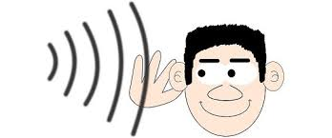
CONCEPTS
2. Practice objectivity
Notes:
Practising objectivity and ensuring you receive all information without bias can help you remain open to the messages and perspectives of your speaker. Even if you have a strong opinion about the topic of conversation, setting aside your opinions in order to receive your speaker's message without judgement can help you consider new possibilities and innovative perspectives

Slide 10

CONCEPTS
3. Reflect
Notes:
Reflecting refers to mirroring your speaker's message in order to convey that you understand their message. Reflecting can help assure speakers of your comprehension and can indicate your engagement in the conversation. This type of active listening skill can be especially helpful when engaging in therapeutic communication. For example, if your speaker says, "I'm tired of working late to make up for others who don't complete their tasks," you could say, "It sounds like you're feeling frustrated and overlooked."

Slide 11
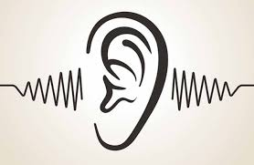
CONCEPTS
4. Clarify
Notes:
An important part of active listening is asking questions when you need clarification. Clarifying aspects of the conversation can indicate you're intently listening and provide you with an opportunity to confirm your understanding. To clarify, you may use specific, simple questions that require a "yes" or "no" as a response or you may ask more general, open-ended questions that require more elaboration from your speaker

Slide 12

CONCEPTS
5. Summarise
Notes:
Restating key themes and summarising content is an effective skill that can contribute to your ability to practice active listening. In the workplace, summarising can help both parties confirm they understand next steps and responsibilities. To summarise, consider offering a brief statement that describes the primary message or key theme of your speaker's message.

Slide 13
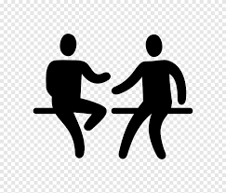
CONCEPTS
6. Use body language
Notes:
Using body language to demonstrate your level of engagement is another important part of active listening. You can use your body language to indicate your understanding by nodding, making eye contact and responding with appropriate facial expressions. Body language may be especially important for professionals who use therapeutic listening to complete their daily duties.

Slide 14

CONCEPTS
7. Share
Notes:
Sharing involves expressing your own thoughts, feelings and experiences to relate to your speaker. This active listening technique can help you contribute to the conversation and align expectations for the next steps, deliverables and responsibilities. You can also use sharing to offer suggestions for improvement, build trust and maintain positive workplace relationships.

Slide 15

CONCEPTS
8. Give your full attention
Notes:
Distractions can make it difficult to focus on the things a speaker is telling you. In order to become a good listener, limit as many distractions as possible and provide the speaker with your undivided attention. This includes silencing your phone, turning off your computer and avoiding the urge to multitask by checking emails or giving your attention to other tasks. This can help you focus on the speaker and make sure that you are taking in everything that they are saying. Managing your time correctly can also help you make sure that you can limit distractions while you are listening.

Slide 16

CONCEPTS
9. Pace the conversation
Notes:
Being a good listener often includes opening a dialogue and allowing for a conversation to start between you and the speaker. Pace the conversation by determining the goal of the speaker's message and evaluating their body language to decide when it is appropriate for you to respond with your own input. Instead of rushing to fill silences, provide time for the speaker to finish their thoughts and acknowledge their message accordingly. This will also give you the time to absorb their message and process what they are saying before it is time for you to respond.

Slide 17

CONCEPTS
10. Ask meaningful questions
Notes:
Once it is time to open up a dialogue, the questions you ask should be meaningful and establish your investment in the speaker's message. Ask questions that can help both you and the speaker reflect on what they said as well as elaborate any points that may need extra clarification. The questions might help the speaker remember other things they wanted to say or open up a new line of dialogue that will be worth exploring.

Slide 18
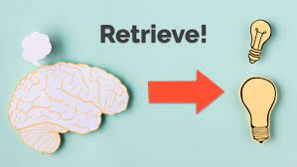
CONCEPTS
11. Recall previous information
Notes:
Recalling information that the speaker has already discussed as well as summarising the points they made in your responses can help you become a more effective listener. Doing this will not only show the speaker you understand what they said, but it will also ensure that they can clarify any misunderstandings and confirm the key points they discussed.

Slide 19
CONCEPTS
Key Differences Between Hearing and Listening
An individual’s ability to perceive sounds, by receiving vibrations through ears, is called the hearing. Listening is something done consciously, that involve the analysis and understanding of the sounds you hear.
The hearing is the primary and continuous in nature, i.e. the first and foremost stage is hearing, followed by listening and it occurs continuously. On the other hand, listening is temporary, as we cannot continuously pay attention to something for long hours.
The hearing is physiological, which is through one of our senses in the living organisms. On the contrary, listening is a psychological (conscious) act.

Slide 20
CONCEPTS
Key Differences Between Hearing and Listening
While hearing is a passive bodily process that does not the involve use of the brain. As opposed to listening, it is an active mental process, which involves the use of brain to draw meaning from words and sentences.
Hearing involves receipt of the message through ears. Conversely, listening encompasses interpretation of the message received by ears.
Hearing is an inborn ability but listening is a learned skill.

Slide 21
CONCEPTS
Key Differences Between Hearing and Listening
In the hearing, we are not aware of the sounds that we receive, however in the case of listening, we are completely aware of what the speaker is saying.
Hearing involves the use of only one sense i.e. ears. In contrast, listening involves the use of more than one senses i.e. eyes, ears, touch etc. to understand the message completely and accurately.
In the hearing, we are neither aware nor do we have any control over the sounds we hear. On the other hand, in listening, we are aware of what the other person is saying and so we listen to acquire knowledge and receive information.
Hearing does not require focus whereas listening does

Slide 22
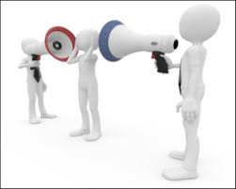
CONCEPTS
Listening Barriers
Notes:
Unfortunately, effective listening can be held back by barriers. These barriers to listening can be grouped into two major categories: external and internal.

Slide 23
CONCEPTS
External Listening Barriers
External listening barriers are easier to manage than internal barriers. They include a variety of environmental distractions that can usually be avoided or minimized with simple corrections, like removing yourself from the interfering barrier or removing the issue from the area that you are in. External barriers include:
Noise. Any external noise can be a barrier, like the sound of equipment running, phones ringing, or other people having conversations.
Visual distractions. Visual distractions can be as simple as the scene outside a window or the goings-on just beyond the glass walls of a nearby office.
Physical setting. An uncomfortable temperature, poor or nonexistent seating, bad odors, or distance between the listener and speaker can be an issue.
Objects. Items like pocket change, pens, and jewelry are often fidgeted with while listening.
The person speaking. The person listening may become distracted by the other person’s personal appearance, mannerisms, voice, or gestures.

Slide 24
CONCEPTS
Internal Listening Barriers
Internal listening barriers are more difficult to manage, as they reside inside the mind of the listener. Internal barriers’ elimination relies on a high level of self-awareness and discipline on the part of the listener, like catching oneself before the mind starts to wander and bringing full attention back to the speaker. Internal barriers include:
Anxiety. Anxiety can take place from competing personal worries and concerns.
Self-centeredness. This causes the listener to focus on his or her own thoughts rather than the speaker’s words.
Mental laziness. Laziness creates an unwillingness to listen to complex or detailed information.
Boredom. Boredom stems from a lack of interest in the speaker’s subject matter.

Slide 25
CONCEPTS
Sense of superiority. This leads the listener to believe they have nothing to learn from the speaker.
Cognitive dissonance. The listener hears only what he or she expects or molds the speaker’s message to conform with their own beliefs.
Impatience. A listener can become impatient with a speaker who talks slowly or draws out the message.

Slide 26




THANK YOU
+91 78150 95095
codemithra@ethnus.com
www.codemithra.com

